Slide 1


Economic Shocks & Education: Lessons from India's Pandemic
An Analysis of Dropout Rates, Digital Access, and Policy
SUBJECT:
Principles Of Analytics (DAMO-500-5)
Submitted by:
Parminder Kaur - NF1030012
Stephanie Nnenna Aneke - NF1019455
Sanusi Nafisat Olamide - NF1016982
SUBMITTED TO:
Patty Zakaria

Slide 2





Research Objective
Understanding the Pandemic's Impact on Educational Resilience
Primary Goal:
To conduct a multi-level analysis of how the COVID-19 economic shock affected India's education sector, examining both national policy and state-level outcomes.
Specific Aims: | Specific Aims: | Specific Aims: | Specific Aims:
Assess the link between national economic health and education funding. | Identify the key state-level drivers of student retention (economics vs. digital access). | Measure the pandemic's direct impact on dropout rates. | Provide evidence- based recommendations for building a more resilient system.

Slide 3





Data Processing
Key Data Processing Steps:
Merging: Manual integration of datasets into a single structured panel on Year and State.
Transformation: Applied natural log transformation to the Internet_Access variable to correct for severe positive skewness and create log_Internet_Access for regression analysis.
Validation: Conducted consistency checks; no missing values were found for major states and key variables across all four years.

Slide 4

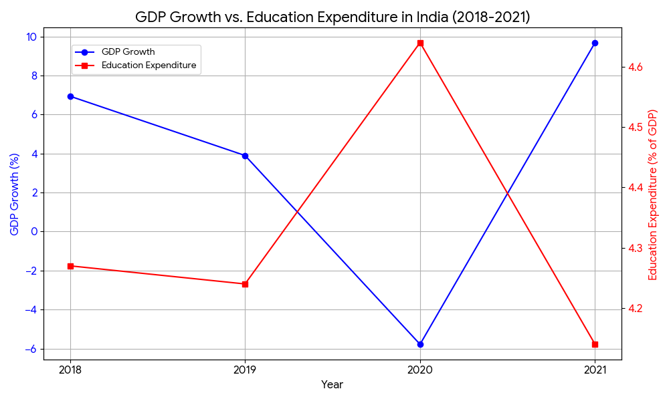
RQ1 & Result: National Fiscal Prioritization
Research Question 1: What was the relationship between India’s GDP growth and education expenditure?
H₀ (Null): There is no significant relationship between GDP growth and education expenditure.
Hₐ (Alternative): Periods of lower GDP growth are associated with a significant decrease in education expenditure.
Test Used: Descriptive Time-Series Analysis (Inferential testing not feasible due to small n=4).
Result: ❌ Fail to Reject H₀
Finding: Education expenditure (% of GDP) remained stable or increased despite a massive economic contraction.
Interpretation: The government shielded the education budget, demonstrating fiscal prioritization during crisis.

Slide 5
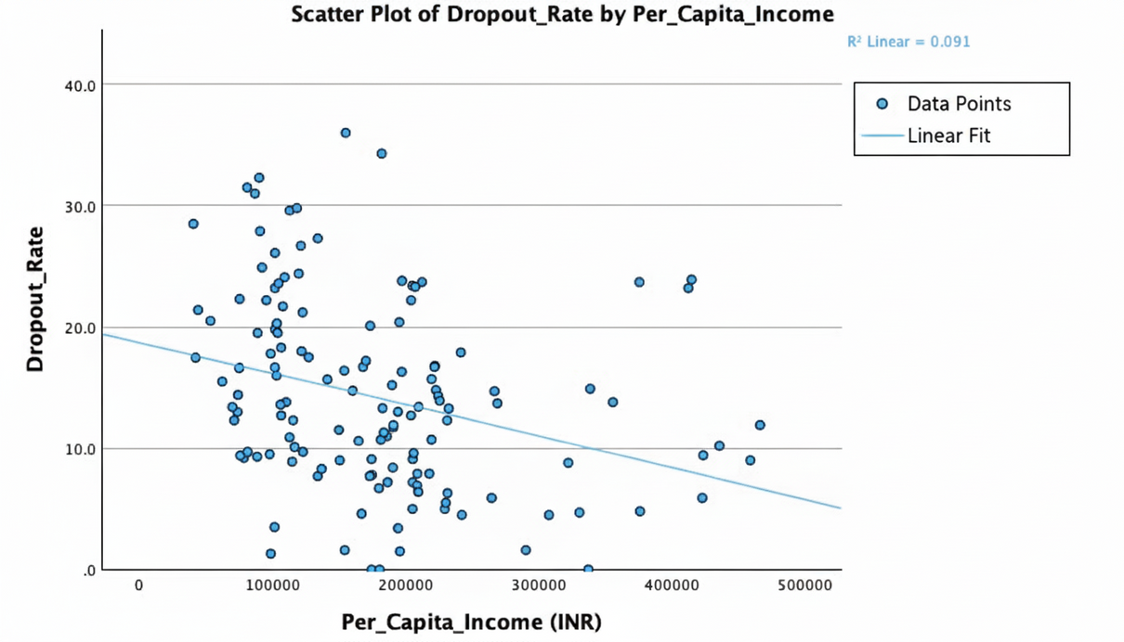
RQ2 & Result: State-Level Economic Primacy
Research Question 2: How do state income and internet access relate to dropout rates?
H₀ (Null): There is no significant relationship between per capita income and dropout rates after controlling for internet access.
Hₐ (Alternative): States with higher per capita income have significantly lower dropout rates after controlling for internet access.
Test Used: Multiple Linear Regression.
Result: ✅ Reject H₀. Support Hₐ
Wealth Matters: Higher income ➔ Significantly lower dropouts (B = -2.097, p = .005). Internet Alone Doesn't: Not a significant predictor (p = .479).
Interpretation: Economic well-being is the primary driver of student retention.

Slide 6
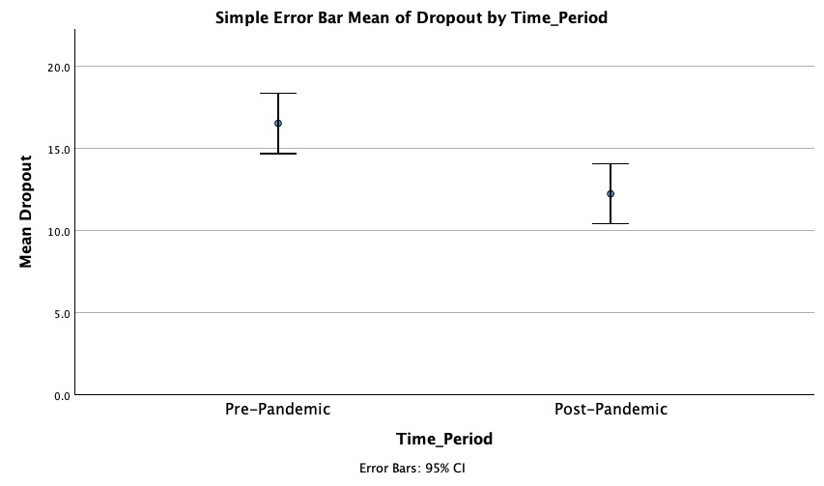
RQ3 & Result: Pandemic Impact & The Digital Shift
Research Question 3: Did the pandemic significantly alter student dropout rates?
H₀ (Null): There is no significant difference in mean dropout rate between pre-pandemic and post-pandemic periods.
Hₐ (Alternative): There is a significant difference in mean dropout rate between pre-pandemic and post-pandemic periods.
Test Used: Independent Samples T-Test. Bivariate Correlation for exploratory analysis.
Result: ✅ Reject H₀. Support Hₐ
Finding: Dropout rates fell significantly from 16.5% (Pre) to 12.2% (Post) (t(134) = 3.29, p = .001).
Nuance: Internet became a significant correlate post-pandemic (r = 0.30, p = 0.015), indicating it was activated as a crisis-mitigation tool. This positive correlation suggests it became a proxy for a state's overall capacity to respond to the educational crisis.

Slide 7




Conclusion & Recommendations
Conclusion: The pandemic proved that economic strength is the foundation of educational resilience, while digital infrastructure is a critical crisis-response tool.
Recommendations:
Safeguard education funding during economic downturns.
Invest in broad economic development to address the root cause of dropouts.
Build digital infrastructure as strategic crisis preparedness.

Slide 8


Study Limitations
1. Short National Time Series
n = 4 data points (2018-2021) for national GDP vs. education spending analysis.
Limited the use of advanced time-series models and generalizability of long-term trends.
2. Broad Economic Proxy
NSDP per capita measures general economic well-being, not specific education investment policies or regional inequalities within states.
3. Internet Access Measurement
Used total subscribers instead of penetration rate (e.g., per 100 people) due to census data unavailability.
May not accurately reflect accessibility at the individual/household level.
4. Cross-Sectional Design
Analysis shows correlation, not causation.
Unmeasured factors (e.g., state policy, cultural attitudes) could influence results.

Slide 9



Thank You

